Slide 1
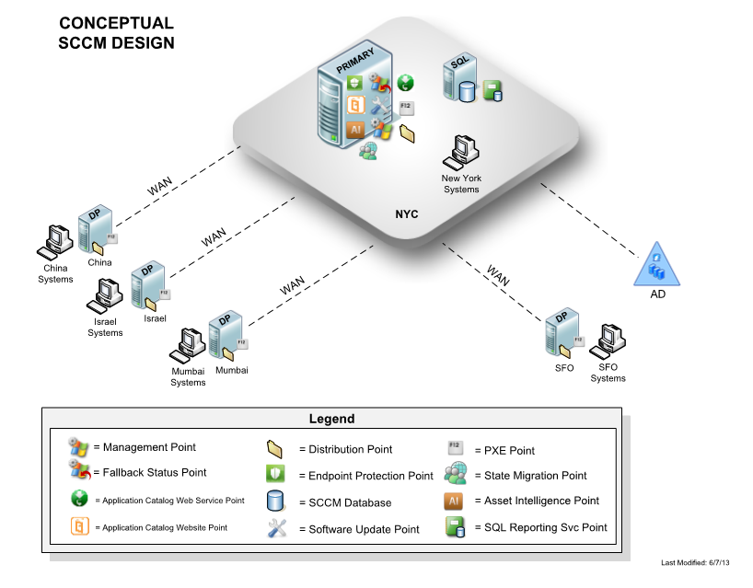
OrbiMed
The Challenge
OrbiMed came to Affirma looking to implement System Center Configuration Manager (SCCM) 2012 to bring some new features and functionality to their environment. The client wanted to implement a variety of features such as software updates, distribution and metering, hardware and software inventory, remote control and OS deployment.
The client was very satisfied with the virtual results and subsequent deployment to a physical machine. We successfully deployed all of the back and current updates to their environment and were able to deploy complex applications, making sure all of the prerequisites were in place for an application launch.
What We Did
Affirma used SCCM 2012 to set up primary site servers and four additional distribution points for OrbiMed’s remote offices.
We set up patching within the system that was to be implemented by department on a monthly basis, as well as the collections for their department necessary for the patches.
We set up the patches to run automatically every Tuesday afternoon and walked the client through the process for them to understand how it worked. The system would go to Microsoft and set up all of the patches into a group, which would then deploy to a set of test machines that filtered out any issues and then roll out the packages to each department. Built a number of custom applications, such as the console for the configuration manager, which they could deploy to whomever needed it. Deployed Windows 8 operating system, which we tested on virtual machines and deployed physically. Provided the client with detailed documentation on how to do application and OS deployments.
Results

